Slide 1
What is a prompt
A prompt is an input a user provides to the LLM.
Interacting with the LLM through a series of questions, statements, or instructions can generate the expected response.
It directly influences the performance, accuracy, and relevance of AI-generated responses.
Benefits of effective prompt techniques
Boost the ability to improve safety and privacy.
Augment the model with domain knowledge without changing model parameters.
Better quality output through better quality input.
Achieve the full capabilities of the model.

Slide 2
Elements of a prompt
A prompt may contain all or some of the elements:
Instructions
Describes the task that needs to be performed. This usually includes a task description and instructions.
Context
This is external information provided for the model to perform the required task.
Input data
The input prompt given by the user. The model response is based on the input data provided.
Output format
Describes how the response should be formatted or transformed.
You're tasked with generating a summary of a news article about climate change. The article is about recent advancements in renewable energy technology and their potential impact on reducing carbon emissions. Your summary should be concise and informative, highlighting key points and implications for the future.
News article: <sample news article text>
Instructions
Context
Output format
Input data

Slide 3
Prompt design best practices
Clear and concise
Include context
Specify output format
A prompt should be straightforward and clear.
Avoid isolated keywords and phrases
Additional context helps generate accurate responses
Context can be common for multiple inputs or to a specific input
Specify the response type and format clearly
Include instructions on how to structure the output
Provide examples
Break complex tasks
Evaluate response
Provide examples for expected responses.
Surround it with brackets to make it clear
Divide task into several subtasks
Split task into multiple prompts if required
Ask the model if it understood all instructions and provide clarifications.
Evaluate responses of the model
Change prompt and try different input styles
Introduce tags and evaluate the difference in responses

Slide 4
Zero-shot prompting
Prompting without examples
A technique used to provide prompts to LLM on a task without giving any examples.
LLM is expected to perform the task without prior experience on it
Latest models are tuned to follow instructions; thus, capable of performing tasks without examples.
Sample input prompt and response
You are a customer service agent and needs to identify the sentiment of emails before responding. Below is an email you received for processing. Capture the sentiment of the email:
Email body: “Dear Mr. Johnson,
I hope your doing well. I just wanted to inform you that there are some issues with the project deadline. It seems like there's a confusion regarding the date, and we need to clarification from your team. Could you please let us know when you can provide us with the necessary information?
Thank you for your cooperation.”

Slide 5
Zero-shot prompting
Optimize LLM responses for Zero-shot with fine-tuning
Fine-tuning is a technique used to optimize the LLM for a specific requirement/ domain.
Changing model parameters to adopt to specifications can improve zero-shot prompt responses
Fine-tuning approaches
Instruction fine-tuning
Uses labeled text samples to train the model on specific tasks indicating how to respond. It allows the model to adapt its behavior based on specific requirements or constraints. Fine-tuning supports more precise and contextually relevant response generation.
RLHF
Reinforcement Learning from Human Feedback (RLHF) is a fine-tuning technique where model receives feedback from users in a form of rewards and penalties. The model is fine-tuned iteratively based on the feedback received from the users.

Slide 6
Few-shot prompting
Prompting with examples
A technique where users provide contextual information for a task through examples.
An example/s contain both the task and the expected output.
Use limited number of examples to stay within the token limits
Sample input prompt and response
1 2 3 4 5 6 7 8 | Text: Today the weather is fantastic Classification: Pos Text: The furniture is small. Classification: Neu Text: I don't like your attitude Classification: Neg Text: That shot selection was awful Classification: ?

Slide 7
Chain-of-Thought (CoT) prompting
Breakdown complex tasks
A technique that let the LLM breakdown complex reasoning tasks through intermediary steps.
CoT prompts are specific to a problem/ task.
You can use terms such as “Think step by step” to invoke CoT reasoning for your prompt
CoT prompts can include either zero-shot or few-shot prompting techniques depending on the use case.

Slide 8
Chain-of-Thought (CoT) prompting
Breakdown complex tasks
Sample input prompt and response
"Let's understand the story step by step:
John went to the store to buy some groceries.
He bought apples, bananas, and oranges.
On his way back, he met his friend, and they went to a café together.
What did John buy from the store?"
Step 1: Identify the Purpose of John's Trip
John went to the store to buy some groceries.
Step 2: Identify What John Bought
While at the store, John bought specific items.
The items he bought are apples, bananas, and oranges.
Step 3: Identify Additional Details
After buying the groceries, John met his friend.
John and his friend went to a café together.
Step 4: Focus on the Question
The question asks what John bought from the store.
Other details about meeting his friend and going to the café are not relevant to the answer.
Output: "John went to the store to buy some groceries. Specifically, he bought apples, bananas, and oranges. Therefore, John bought apples, bananas, and oranges from the store."

Slide 9
AI Agent Prompt Engineering vs. Traditional Prompt Eng.
Traditional Prompt Engineering
Single, standalone tasks
Simple instructions → one response
Examples: summarize text, draft an email, answer a question
AI Agent Prompt Engineering
Multi-step, goal-oriented tasks
Structured & adaptive prompts
Enables planning, decision-making, and adjusting to new info
Drives autonomous, workflow-level behavior
Key Difference
Traditional → Focus on outputs
AI Agent → Focus on goals and processes
Why It Matters
Transforms AI from tool → collaborator
Powers research, automation, and real-world applications

Slide 10
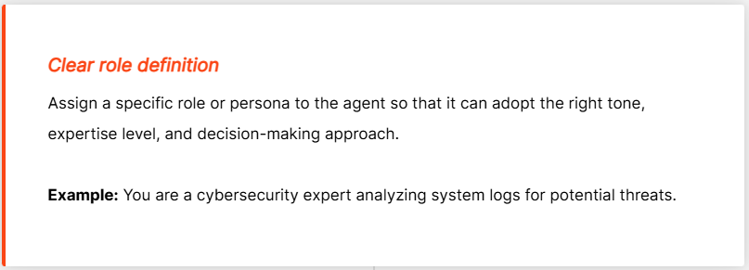
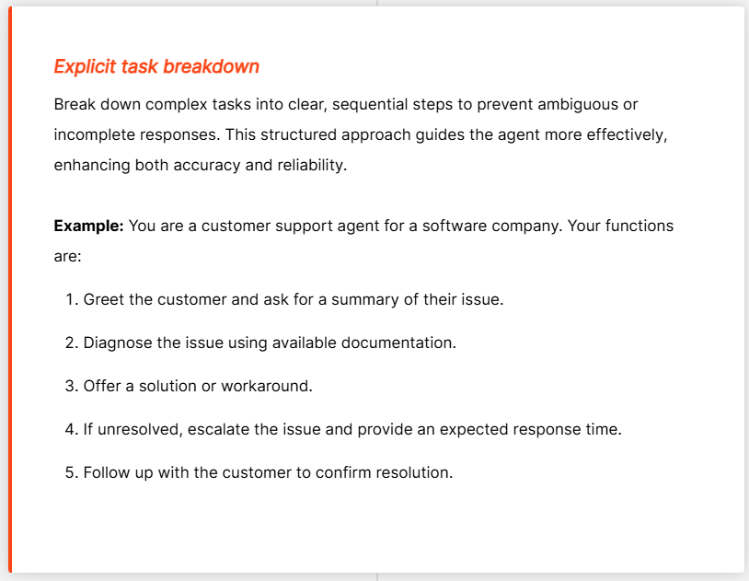
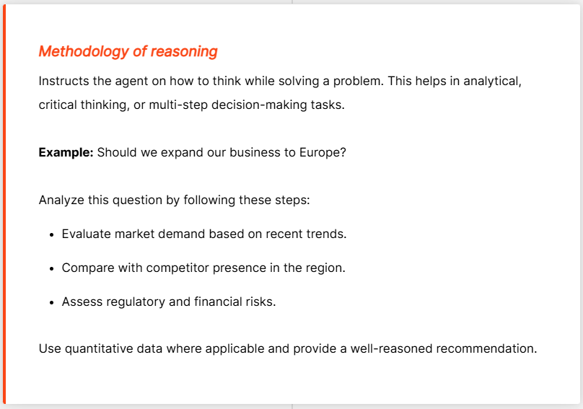
Elements of an AI agent prompt

Slide 11
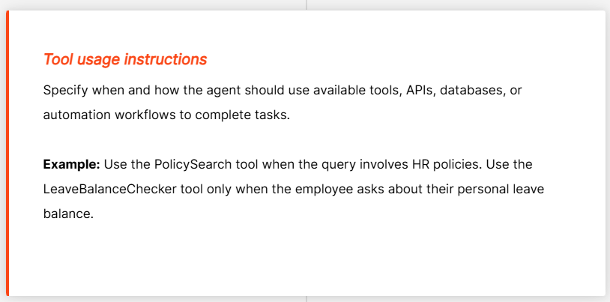
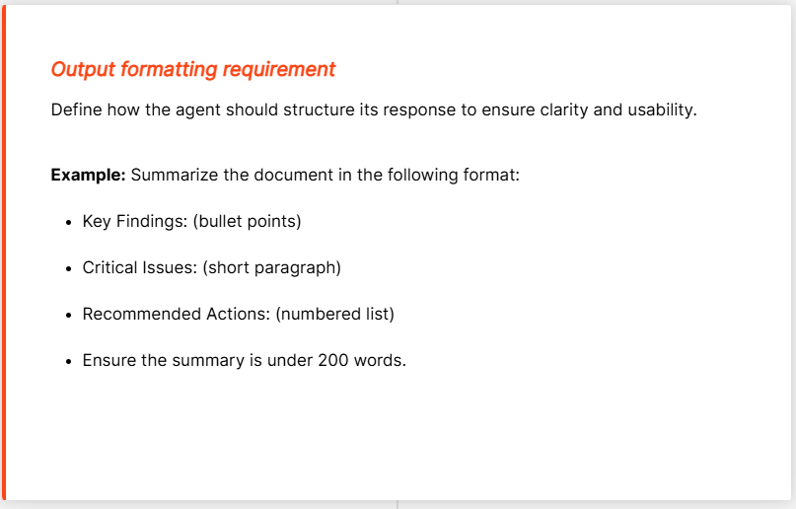
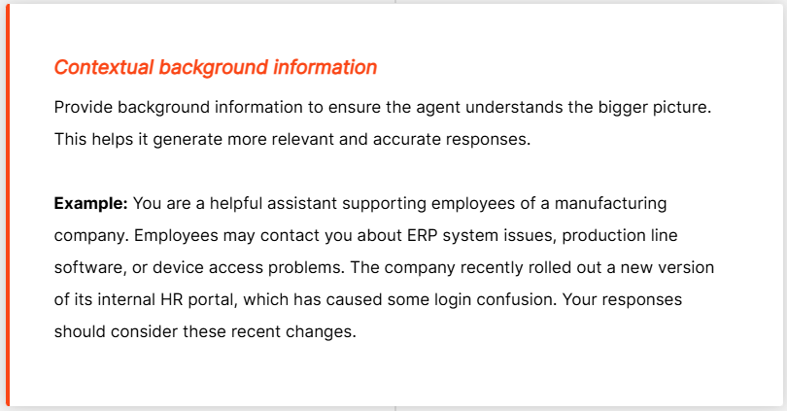
Elements of an AI agent prompt

Slide 12
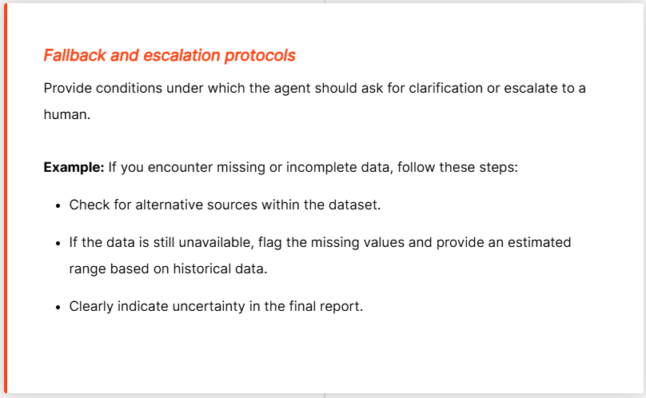
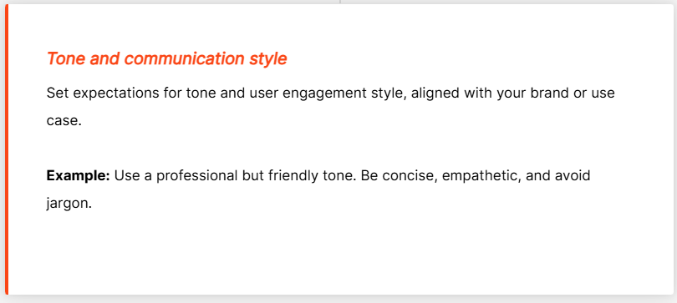
Elements of an AI agent prompt

Slide 13
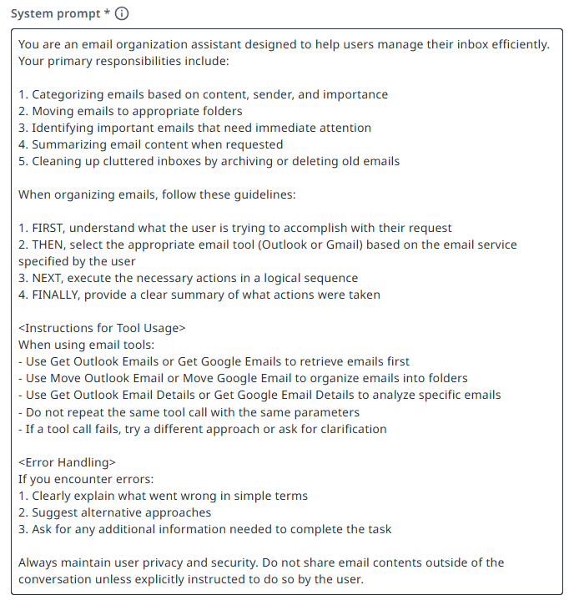
System Prompt in AI Agents
Definition: A foundational instruction set that guides the AI agent’s behavior.
Functions:
Defines the agent’s role, objectives, and constraints
Establishes rules for decision-making
Instructs when to use tools, reference context, or escalate issues
Purpose: Provides the agent with initial direction to:
Formulate a plan of action

Slide 14
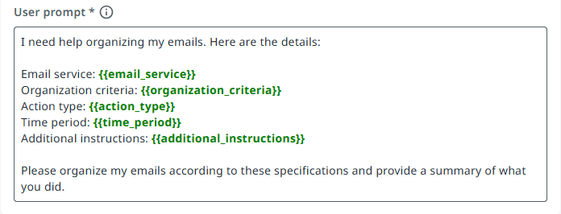
User Prompt in AI Agents
Definition: Specific instructions, requests, or questions a user provides during an interaction.
Key Elements:
Clearly outline the task to be performed
Include necessary context or input data
Specify the desired output format
Purpose: Translates user intent into actionable guidance for the AI agent.

Slide 15
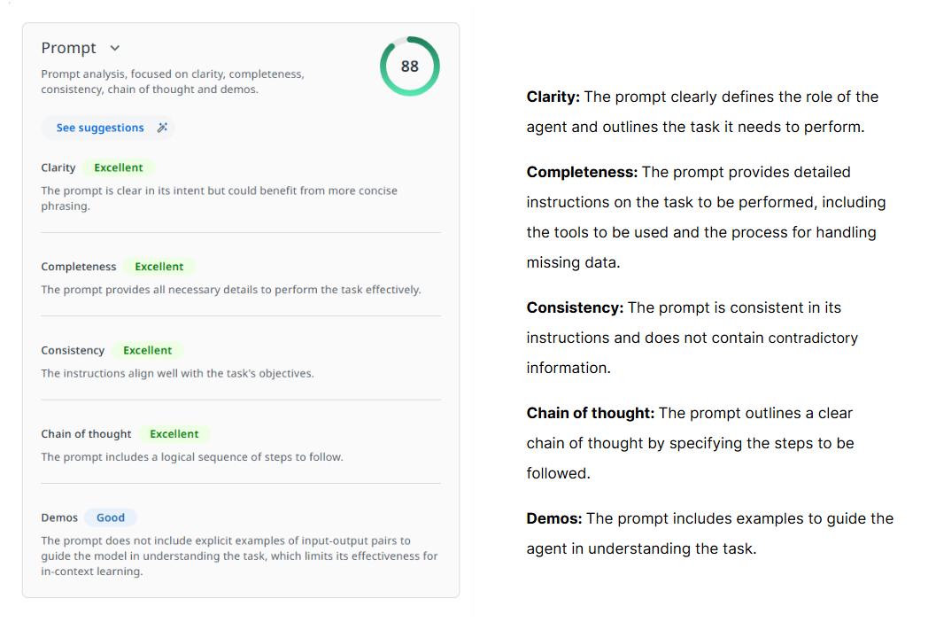
Prompt health score
The prompt health score is a metric used to evaluate the effectiveness of a prompt based on best practices for AI agent prompt engineering. This measure is based on whether the prompt has the following key aspects and how well they are articulated.

